Slide 1
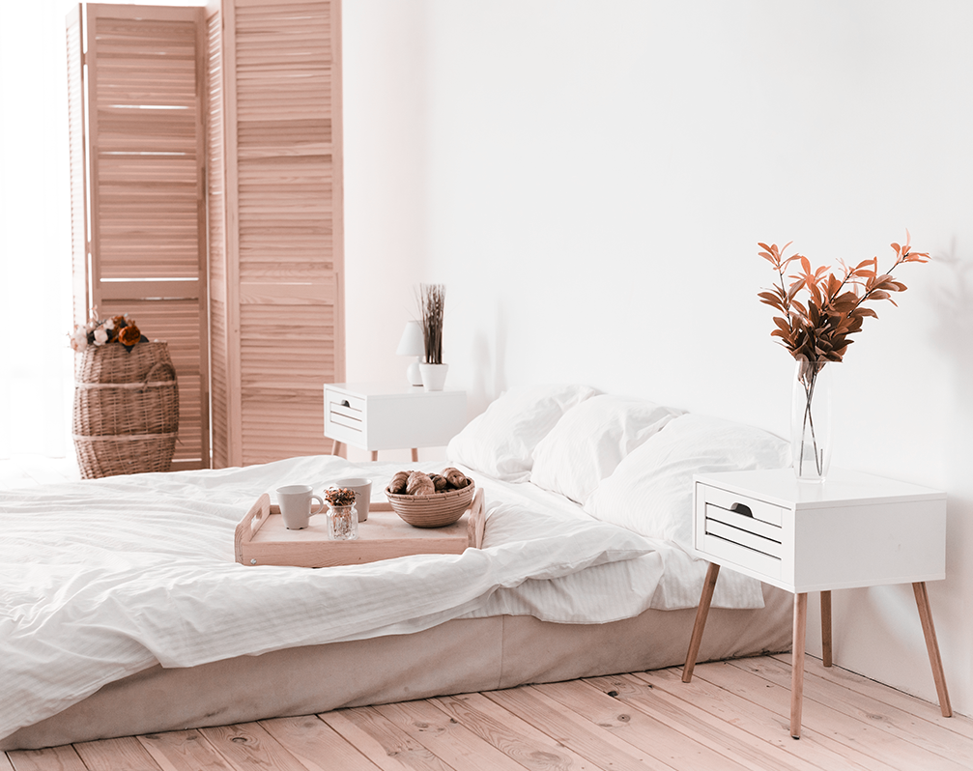

Best choice for newcomers to Singapore

Slide 2
1
2
3
You’re looking for
Short stay
Single and Couple
Low-cost Trip
Casual stay within a week
Suitable for both single and couple
The better price
The better saving

Slide 3
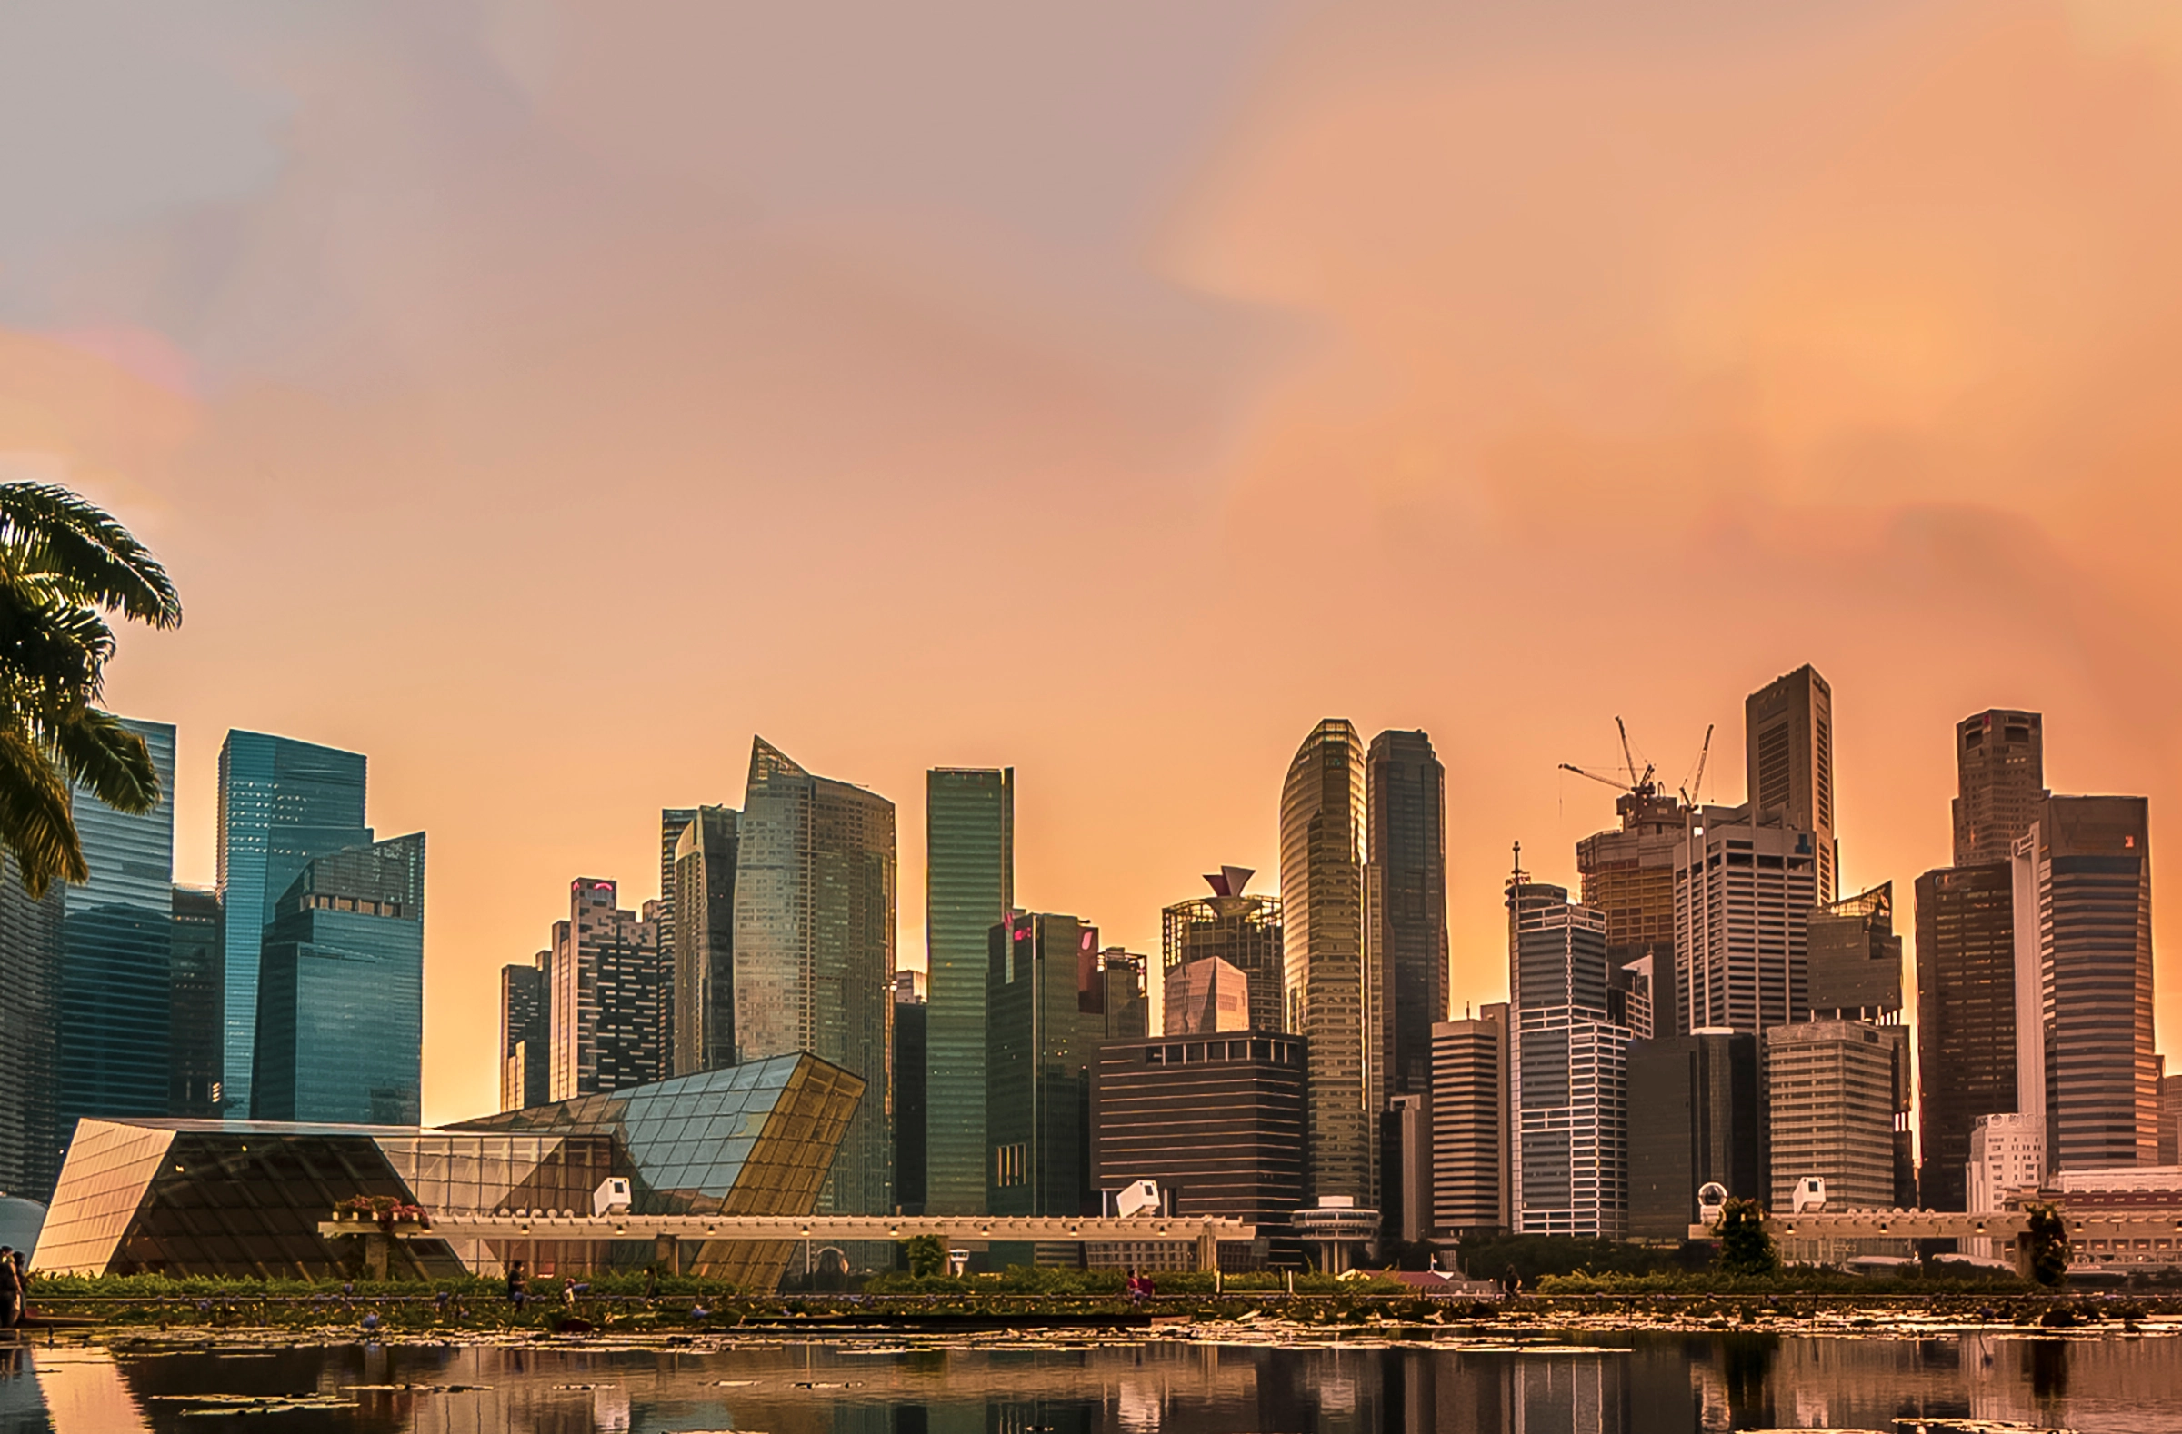
When & Where
WHEN is the balance time to visit and renting not too high
WHERE is the convenient of transportation and entertainment

Slide 4
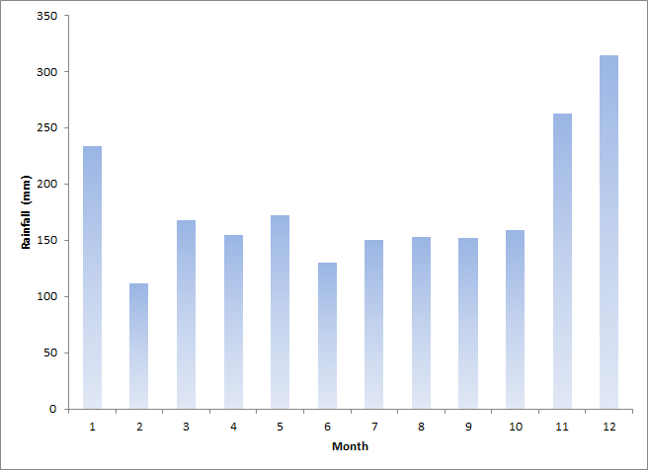
WHEN to come …
According to www.weather.gov.sg, rainfall is plentiful in Singapore and it rains an average of 167 days in a year.
Mostly from the lately of October to the February in the next year.

Slide 5
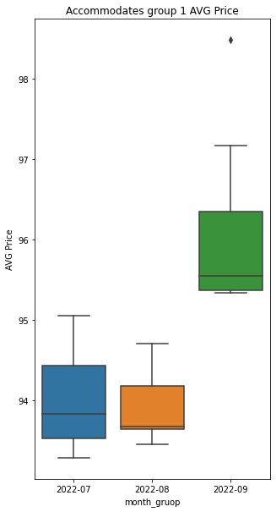
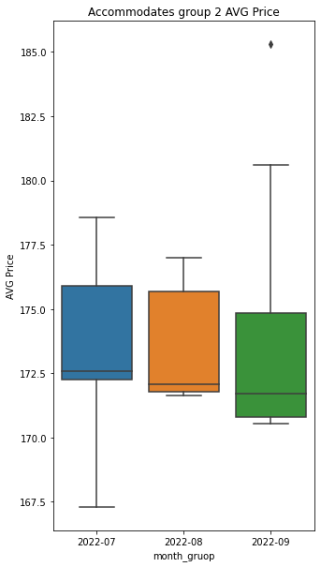
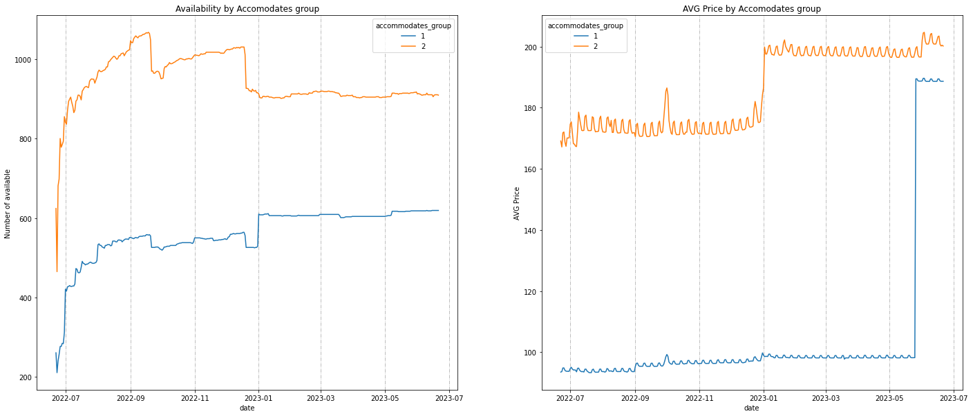

WHEN to come …
Heavy rainy season

Slide 6
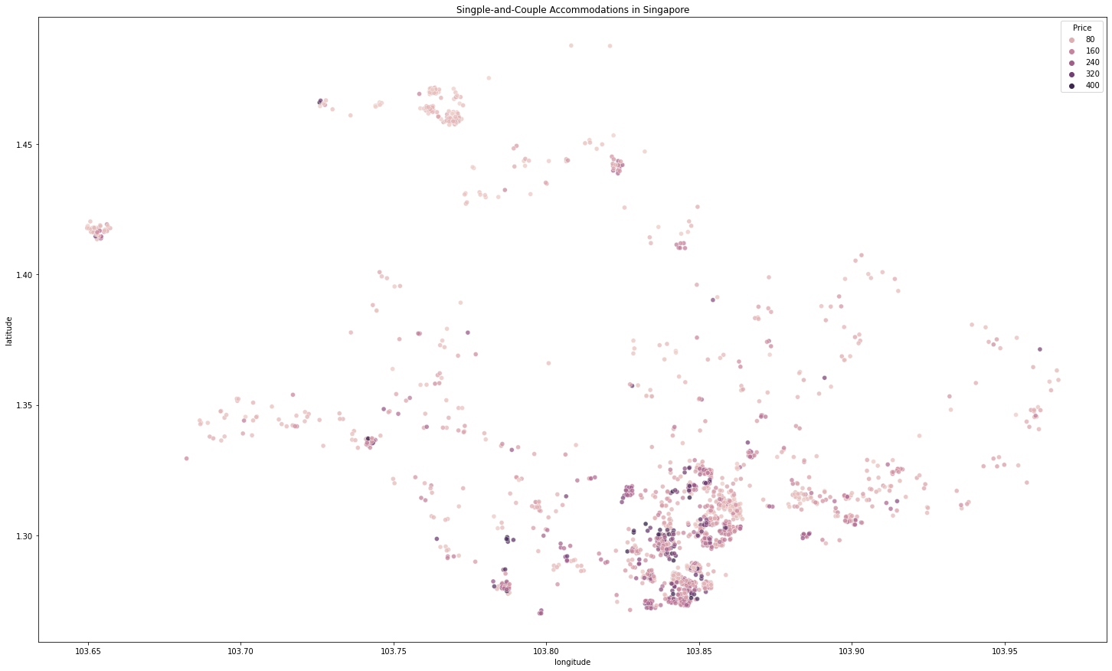
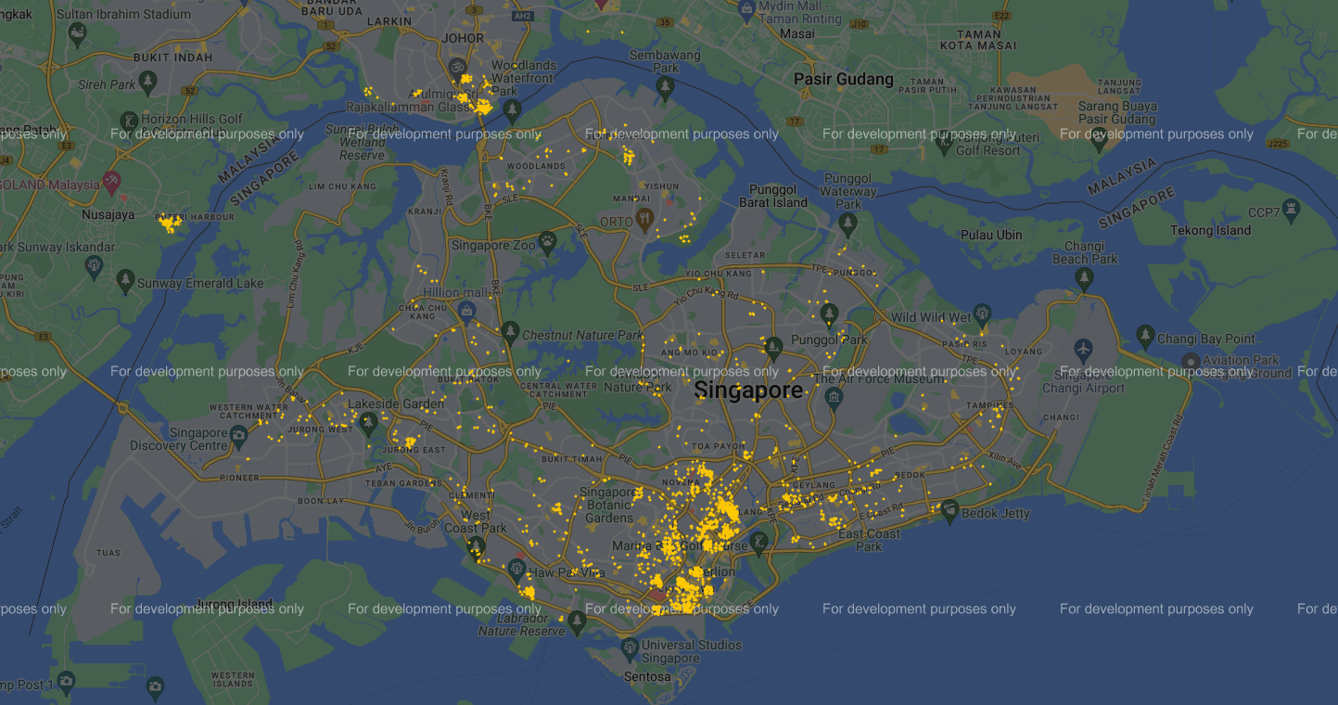
WHERE to stay…
Rochor & Victoria Crossroad
China town

Slide 7
Single
I
Pro
II
Premium
III
Conclusion
Mercury is the closest planet to the Sun and the smallest
Saturn is a gas giant, composed mostly of hydrogen and helium
Jupiter is the biggest planet in the Solar System

